Slide 1





CIPHATHON 26’
- Problem Statement: Browser-Level Sensitive Data Leakage Prevention from LLMs
- Team Name: AWANSAY
- Team Members: 2

Slide 2

LeakShield:Real-Time Secret
Protection Tool
Proposed Solution –
Detailed Explanation of the Proposed Solution
Browser Monitoring: A Chrome extension monitors GitHub issue text in real time and sends it to a backend server for analysis.
Secret Detection: The backend uses regex and a CodeBERT model to detect and highlight sensitive information before submission.
2. How the Solution Addresses the Problem
Prevents Credential Leaks: Detects API keys, tokens, and passwords before they are publicly posted on GitHub.
Real-Time Workflow Protection: Works directly inside GitHub while typing, providing instant security warnings.
3. Innovation and Uniqueness of the Solution
Hybrid Detection Method: Combines regex pattern matching with machine learning for faster and more accurate secret detection.
Browser-Level Security: Prevents leaks before publishing by integrating directly into the developer’s workflow.

Slide 3
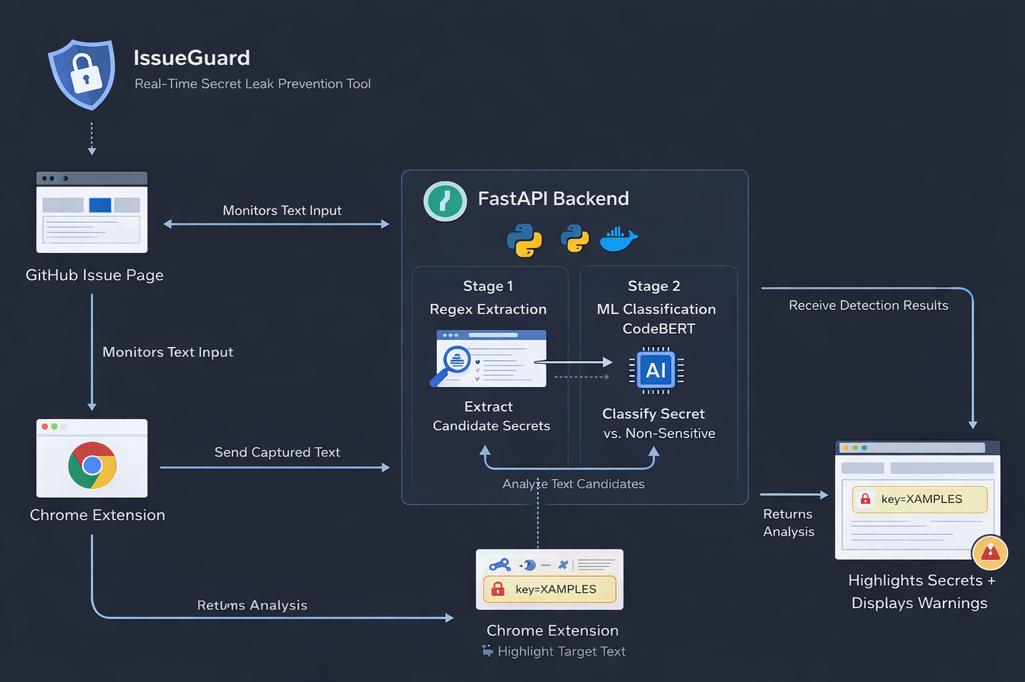
Technical Approach
Technologies Used Languages: JavaScript, Python, HTML/CSS Frameworks/Libraries: FastAPI, CodeBERT, Regex Tools/Platforms: Google Chrome, Docker, GitHub Hardware: Laptop/Desktop (optional GPU)
Methodology: Chrome extension monitors GitHub issue text. Text is sent to backend using FastAPI API. Regex extracts possible secrets. CodeBERT classifies them as Secret or Non-Sensitive. Results are returned and secrets are highlighted with warnings.

Slide 4
FEASIBILITY AND VIABILITY
Feasibility of the Idea - Uses widely available technologies like JavaScript, Python, and Chrome Extensions, making development practical. Integrates easily with GitHub pages without modifying the platform. Lightweight backend using FastAPI and CodeBERT enables efficient real-time detection.
Potential Challenges and Risks - False positives or negatives in detecting secrets. Latency issues if backend processing becomes slow. User privacy concerns when sending text to the backend server.
Strategies to Overcome Challenges - Use machine learning (CodeBERT) with regex to improve detection accuracy. Optimize backend processing and caching to reduce response time. Implement secure API communication and minimal data storage to protect user privacy.

Slide 5
IMPACT AND BENEFITS
1. Potential Impact on Target Audience –
Helps developers prevent accidental exposure of sensitive credentials while creating issues on GitHub.
Improves software security practices by providing real-time alerts during development.
Supports organizations and open-source communities in protecting confidential data.
2. Benefits of the Solution -
Security / Social Benefits Reduces risk of data breaches caused by leaked API keys, tokens, or passwords. Promotes safer coding and responsible data handling among developers.
Economic Benefits Prevents financial losses caused by compromised credentials or cyberattacks. Reduces costs related to security incidents and system recovery.
3. Technical Benefits - Provides real-time detection using regex and the CodeBERT model for better accuracy. Easy integration with existing developer workflows through a browser extension.

Slide 6
Conclusion
IssueGuard prevents accidental leakage of sensitive credentials such as API keys, tokens, and passwords.
Real-time monitoring through a Chrome extension alerts developers before sensitive data is publicly posted.
Hybrid detection using Regex + CodeBERT improves accuracy and reduces false positives.
Seamless integration with developer workflow ensures security without interrupting productivity.

Slide 7
REFERENCES
https://arxiv.org/abs/2002.08155
https://github.com/nafiurahman00/IssueGuard

